Slide 1
Morphological Image Processing
Mr. Sunanda Das
Assistant Professor, Dept. of CSE, KUET

Slide 2
Preview
Morphology “ – a branch in biology that deals with the form and structure of animals and plants.
Mathematical morphology as a tool for extracting image components that are useful in the representation and description of region shape, such as boundaries, skeletons, and the convex hull.

Slide 3
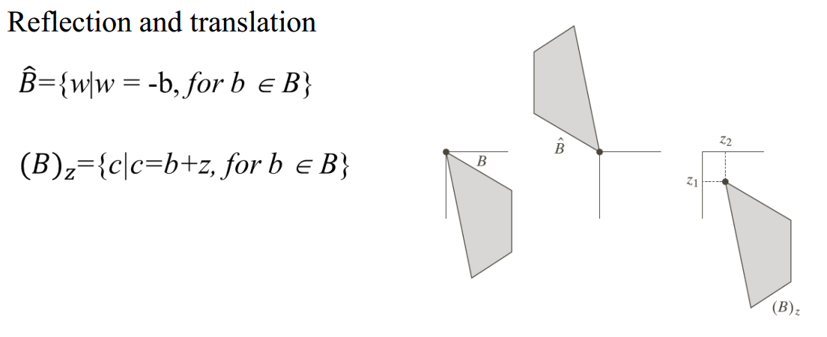
Preliminaries

Slide 4
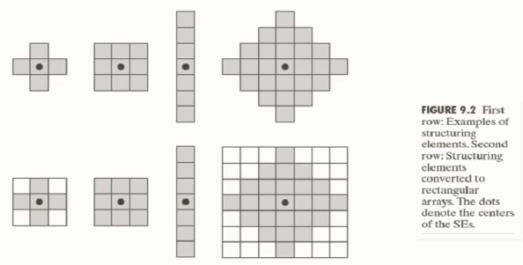
Structuring Elements
Morphological operations are defined based on structuring element.
A structuring element is a small sets or sub images used to probe an image under study.
Typically, a structural element is much smaller than the processed. The shape of the structured element can be arbitrary, as long as it can be represented as a binary image of a given size.

Slide 5
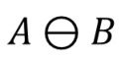
Erosion
1 | 1 | 1 | 1 | 1 | 1
1 | 1 | 0 | 0 | 1 | 1
1 | 0 | 0 | 0 | 0 | 1
1 | 1 | 0 | 0 | 1 | 1
1 | 1 | 1 | 1 | 1 | 1
0 | 0 | 0 | 0 | 0 | 0
1 | 0 | 0 | 0 | 0 | 1
1 | 0 | 0 | 0 | 0 | 1
1 | 0 | 0 | 0 | 0 | 1
0 | 0 | 0 | 0 | 0 | 0
1
1
1

Slide 6
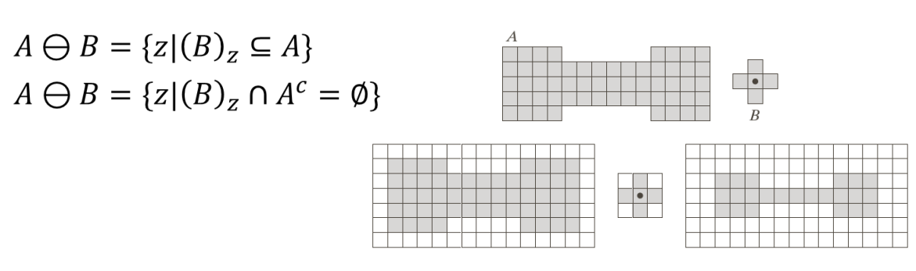
Erosion
Erosion is shrinking or thinning operation
The erosion of A by B is denoted by

Slide 7
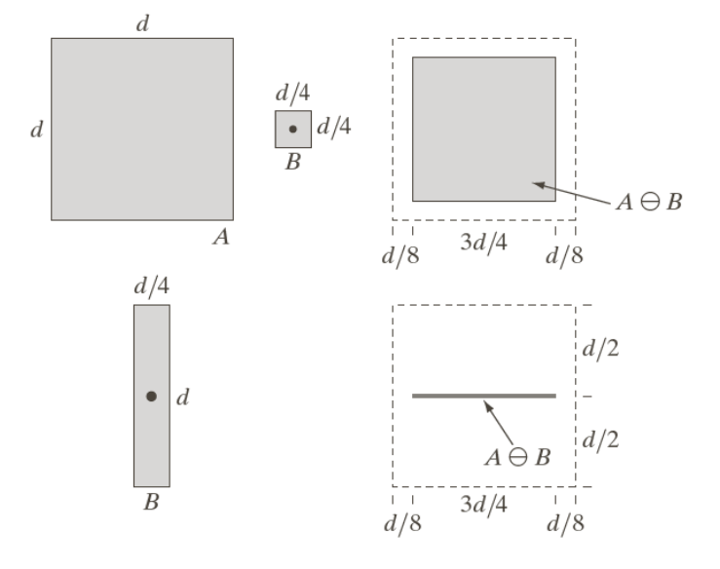
Erosion Example

Slide 8
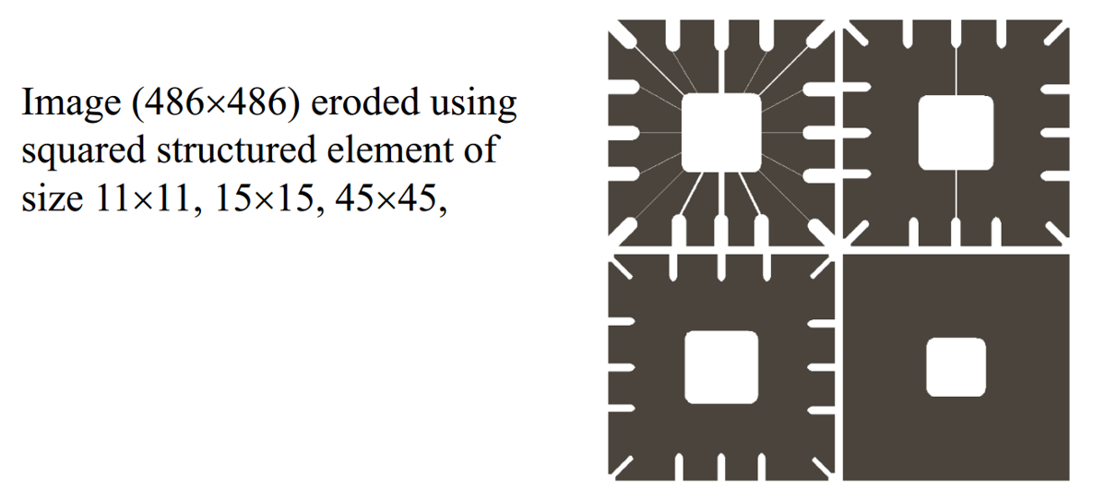
Erosion Example

Slide 9
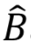
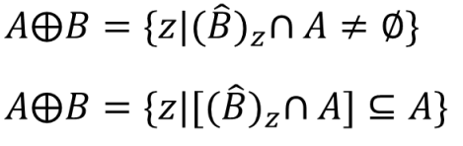
Dilation
Dilation grows or thickens object
The dilation of A and B is set of all displacement z, such that and A overlap by at least one element.

Slide 10
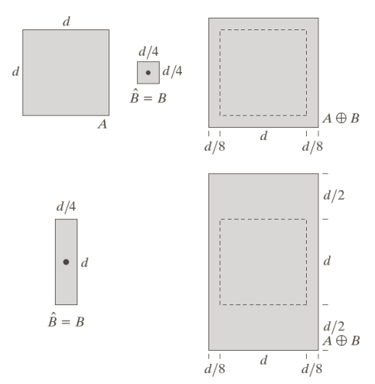
Dilation Example

Slide 11
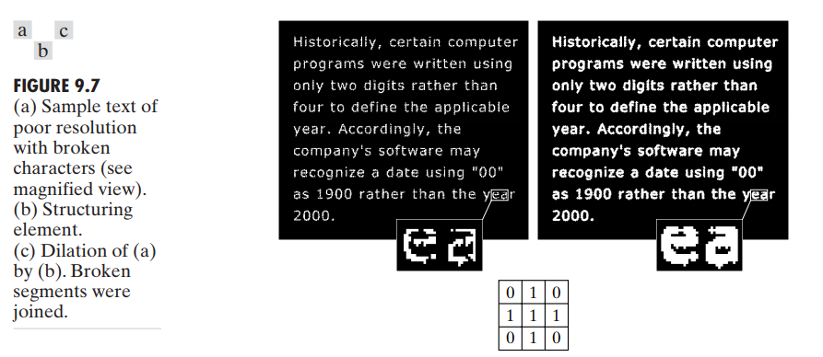
Dilation Example

Slide 12
Example of Dilation
Set B
0 | 0 | 0 | 0 | 0 | 0
0 | 0 | 1 | 1 | 0 | 0
0 | 0 | 0 | 0 | 1 | 0
0 | 0 | 1 | 1 | 0 | 0
0 | 1 | 0 | 0 | 1 | 0
0 | 0 | 0 | 0 | 0 | 0
0 | 0 | 0 | 0 | 0 | 0
0 | 0 | 1 | 1 | 1 | 0
0 | 0 | 0 | 0 | 1 | 1
0 | 0 | 1 | 1 | 1 | 0
0 | 1 | 1 | 0 | 1 | 1
0 | 0 | 0 | 0 | 0 | 0
1 | 1
1 | 1
Reflection of B
Set A
A B

Slide 13
Example of Dilation
Set B
0 | 0 | 0 | 0 | 0 | 0
0 | 0 | 1 | 1 | 0 | 0
0 | 0 | 0 | 0 | 1 | 0
0 | 0 | 1 | 1 | 0 | 0
0 | 1 | 0 | 0 | 1 | 0
0 | 0 | 0 | 0 | 0 | 0
0 | 0 | 0 | 0 | 0 | 0
0 | 0 | 1 | 1 | 1 | 0
0 | 0 | 0 | 0 | 1 | 1
0 | 0 | 1 | 1 | 1 | 0
0 | 1 | 1 | 0 | 1 | 1
0 | 0 | 0 | 0 | 0 | 0
1 | 1
1 | 1
Reflection of B
Set A
A B

Slide 14
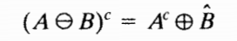
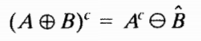
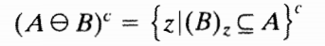
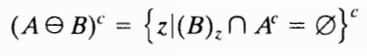
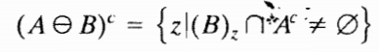
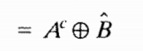
Duality
Erosion and dilation are duals of each other with respect to set complementation and reflection.

Slide 15
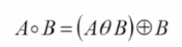
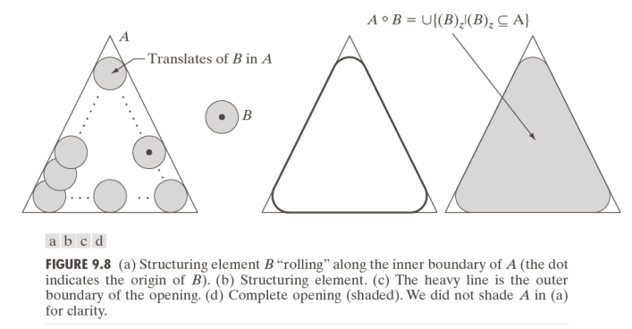
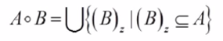
Opening
An erosion followed by dilation
the opening of A by B is obtained by taking the union of all translates of B that fit into A .

Slide 16
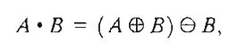
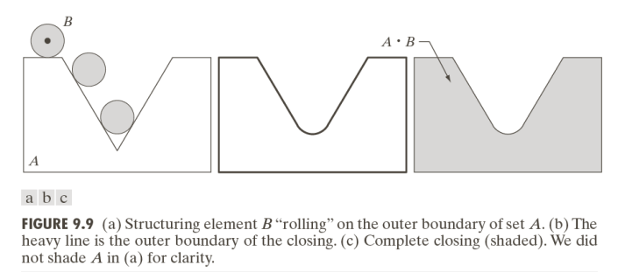
Closing
A dilation followed by erosion

Slide 17
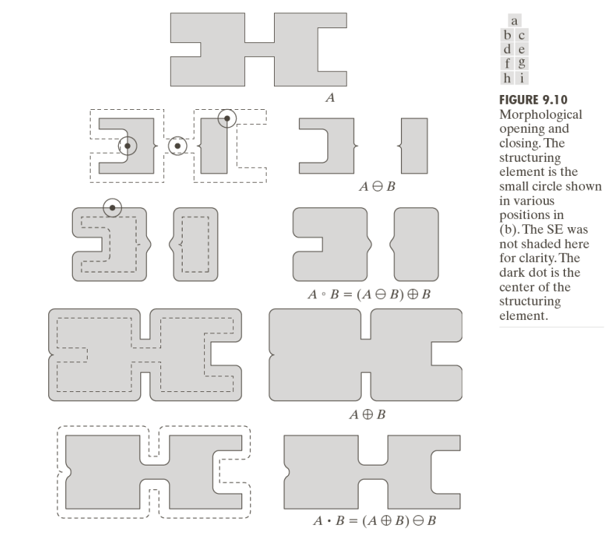

Slide 18
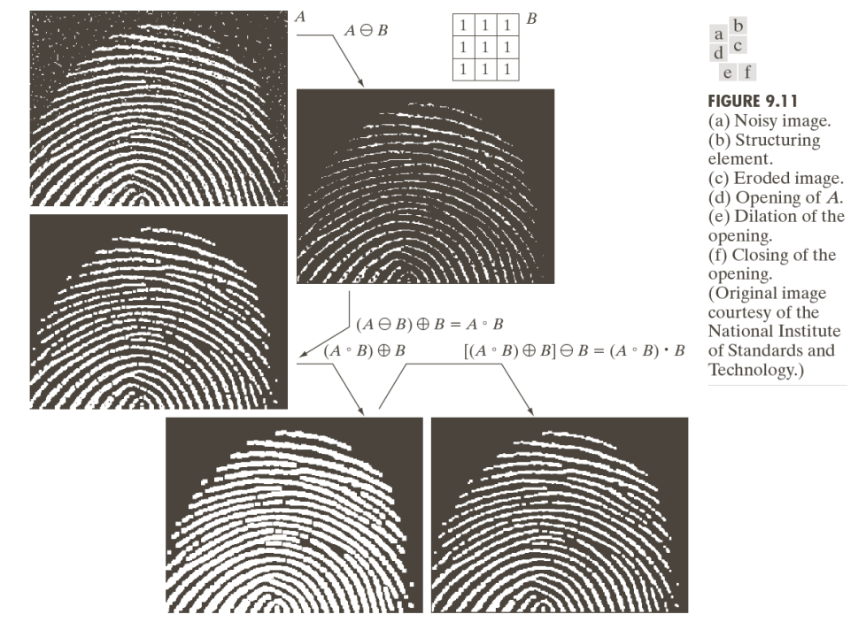

Slide 19
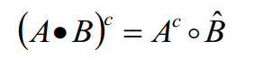
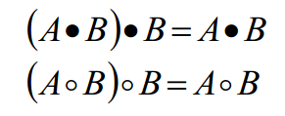
Opening and Closing
Opening and closing are duals of each others
A B is a subset or sub-image of A
A is a subset or sub-image of A B
Once an image been opened or closed, the re-application of same operation has no effect.

Slide 20
The Hit-or-Miss Transform
A basic tools to detect object with given shape and size

Slide 21
Hit-or-Miss Transformation
Set A
W
X
Structure element

Slide 22
Hit-or-Miss Transformation
Set A
A Ɵ X
W
X
W-X
Structure element

Slide 23
Hit-or-Miss Transformation
A complement
A^{C} Ɵ (W-X)
W-X

Slide 24
Hit-or-Miss Transformation
A Ɵ X
A^{C} Ɵ (W-X)
(A Ɵ X) ∩ (A^{C} Ɵ (W-X)) =?

Slide 25
Hit-or-Miss Transformation
Generalized equation
B = (B₁, B₂)
A B = (A Ɵ B₁ ) ∩ (A^{C} Ɵ B₂)
*

Slide 26
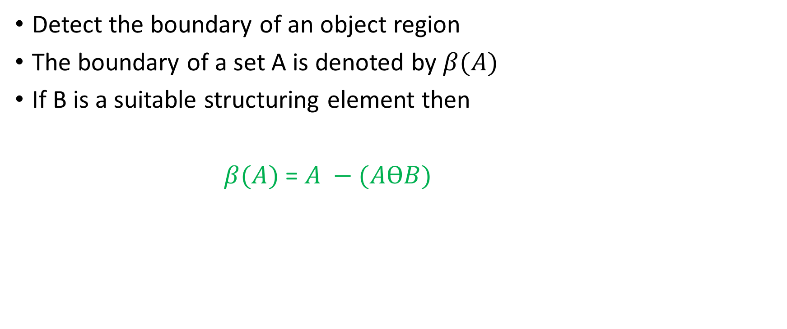
Boundary Extraction
Detect the boundary of an object region
The boundary of a set A is denoted by $β(A)$
If B is a suitable structuring element then
$β(A)$ = $A −(AϴB)$

Slide 27
Boundary Extraction
B
A

Slide 28
Boundary Extraction
B
A Ɵ B

Slide 29
Boundary Extraction
B
A – (A Ɵ B)
Boundary of an Object denoted by β(A) = A - A Ɵ B

Slide 30
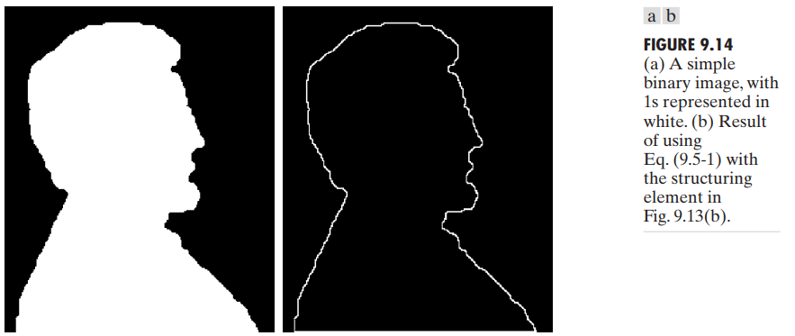
Boundary Extraction
1 | 1 | 1
1 | 1 | 1
1 | 1 | 1

Slide 31
Hole Filling
Fill up the hollow region within a boundary

Slide 32
Hole Filling
 | *
Set B
Set A

Slide 33
Hole Filling
 | *
Set B
It’s an iterative process
Let assume X₀ = P
X_{k} = (X_{k-1} B) ∩ A^{c}
Set A
We have a pixel named P

Slide 34
Hole Filling
 |  |  |  | 1
 |  |  | 1 | 1 | 1
 |  |  |  | 1
 | *
Set B
Iteration 1
X₀ = P = 1
X₁ = (X₀ B) ∩ A^{c}
X₀ B

Slide 35
Hole Filling
 | *
 |  |  |  | 1
 |  |  | 1 | 1 | 1
 |  |  |  | 1
X₁ = (X₀ B) ∩ A^{c} =?
Set A^{c}
X₀ B

Slide 36
Hole Filling
 |  |  |  | 1
 |  |  | 1 | 1
 |  |  |  | 1
 | *
Set B
Iteration 2
X₂ = (X₁ B) ∩ A^{c}
X₁ = (X₀ B) ∩ A^{c}

Slide 37
Hole Filling
 |  |  |  | 2
 |  |  | 2 | 1
 |  |  | 1 | 1
 |  |  | 2 | 1 | 2
 | *
Set B
Iteration 3
X₃ = (X₂ B) ∩ A^{c}
X₂ = (X₁ B) ∩ A^{c}

Slide 38
Hole Filling
 |  |  |  | 3
 |  |  | 3 | 2
 |  |  | 2 | 1
 |  |  | 1 | 1
 |  | 3 | 2 | 1 | 2
 | *
Set B
Iteration 4
X₄ = (X₃ B) ∩ A^{c}
X₃ = (X₂ B) ∩ A^{c}

Slide 39
Hole Filling
 |  |  |  | 4
 |  |  | 4 | 3
 |  |  | 3 | 2
 |  |  | 2 | 1
 |  |  | 1 | 1
 |  | 3 | 2 | 1 | 2
 | *
Set B
Iteration 5
X₅ = (X₄ B) ∩ A^{c}
X₄ = (X₃ B) ∩ A^{c}

Slide 40
Hole Filling
 |  |  |  | 5
 |  |  | 5 | 4
 |  |  | 4 | 3
 |  |  | 3 | 2
 |  |  | 2 | 1
 |  |  | 1 | 1
 |  | 3 | 2 | 1 | 2
 | *
Set B
Iteration 6
X₆ = (X₅ B) ∩ A^{c}
X₅ = (X₄ B) ∩ A^{c}

Slide 41
Hole Filling
 |  |  | 6 | 5
 |  | 6 | 5 | 4
 |  |  | 4 | 3
 |  |  | 3 | 2
 |  |  | 2 | 1
 |  |  | 1 | 1
 |  | 3 | 2 | 1 | 2
 | *
Set B
Iteration 7
X₇ = (X₆ B) ∩ A^{c}
X₆ = (X₅ B) ∩ A^{c}

Slide 42

Hole Filling
 |  |  | 6 | 5
 |  | 6 | 5 | 4
 |  |  | 4 | 3
 |  |  | 3 | 2
 |  |  | 2 | 1
 |  |  | 1 | 1
 |  | 3 | 2 | 1 | 2
 | *
Set B
Process terminate
X₇ = X₆
X_{k} = X_{k-1}
X₇ = (X₆ B) ∩ A^{c}
Final Set = ${ X}_{k}∪A$

Slide 43
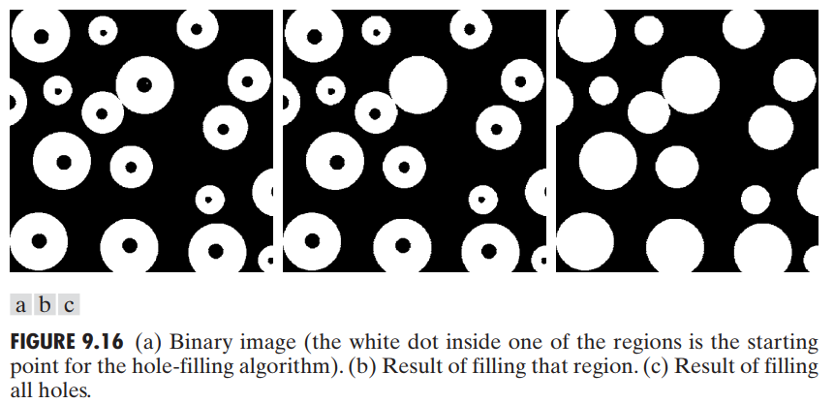
Hole Filling

Slide 44
Extraction of Connected Components
 | *
Set B
It’s an iterative process
Let assume X₀ = P
X_{k} = (X_{k-1} B) ∩ A
Set A
We have a pixel named P

Slide 45
Extraction of Connected Components
 |  |  | 1 | 1 | 1
 |  |  | 1 | 1 | 1
 |  |  | 1 | 1 | 1
 | *
Set B
Iteration 1
X₀ = P
X₁ = (X₀ B) ∩ A
X₀ B

Slide 46
Extraction of Connected Components
 |  |  | 1 | 1 | 1
 |  |  | 1 | 1 | 1
 |  |  | 1 | 1 | 1
X₁ = (X₀ B) ∩ A =?
X₀ B
Set A

Slide 47
Extraction of Connected Components
 |  |  | 1 | 1 | 1
 |  |  |  | 1
 | *
Set B
Iteration 2
X₂ = (X₁ B) ∩ A
X₁ = (X₀ B) ∩ A

Slide 48
Extraction of Connected Components
 |  |  |  |  |  | 2
 |  |  | 1 | 1 | 1 | 2
 |  | 2 |  | 1
 |  |  | 2
 | *
Set B
Iteration 3
X₃ = (X₂ B) ∩ A
X₂ = (X₁ B) ∩ A

Slide 49
Extraction of Connected Components
 |  |  |  |  |  | 3
 |  |  |  |  |  | 2 | 3
 |  |  | 1 | 1 | 1 | 2
 |  | 2 |  | 1
 |  |  | 2
 | *
Set B
Iteration 4
X₄ = (X₃ B) ∩ A
X₃ = (X₂ B) ∩ A

Slide 50
Extraction of Connected Components
 |  |  |  |  |  | 4
 |  |  |  |  |  | 3 |  | 4
 |  |  |  |  |  | 2 | 3 | 4
 |  |  | 1 | 1 | 1 | 2
 |  | 2 |  | 1
 |  |  | 2
 | *
Set B
Iteration 5
X₅ = (X₄ B) ∩ A
X₄ = (X₃ B) ∩ A

Slide 51
Extraction of Connected Components
 |  |  |  |  |  |  | 5
 |  |  |  |  |  | 4 |  | 5 | 5
 |  |  |  |  |  | 3 |  | 4 | 5
 |  |  |  |  |  | 2 | 3 | 4 | 5
 |  |  | 1 | 1 | 1 | 2
 |  | 2 |  | 1
 |  |  | 2
 | *
Set B
Iteration 6
X₆ = (X₅ B) ∩ A
X₅ = (X₄ B) ∩ A

Slide 52
Extraction of Connected Components
 |  |  |  |  |  |  | 5 | 6 | 6
 |  |  |  |  |  | 4 |  | 5 | 5
 |  |  |  |  |  | 3 |  | 4 | 5
 |  |  |  |  |  | 2 | 3 | 4 | 5
 |  |  | 1 | 1 | 1 | 2
 |  | 2 |  | 1
 |  |  | 2
 | *
Set B
Iteration 7
X₇ = (X₆ B) ∩ A
X₆ = (X₅ B) ∩ A

Slide 53
Extraction of Connected Components
 |  |  |  |  |  |  | 5 | 6 | 6
 |  |  |  |  |  | 4 |  | 5 | 5
 |  |  |  |  |  | 3 |  | 4 | 5
 |  |  |  |  |  | 2 | 3 | 4 | 5
 |  |  | 1 | 1 | 1 | 2
 |  | 2 |  | 1
 |  |  | 2
 | *
Set B
Process Terminate
X₇ = X₆
X₇ = (X₆ B) ∩ A

Slide 54
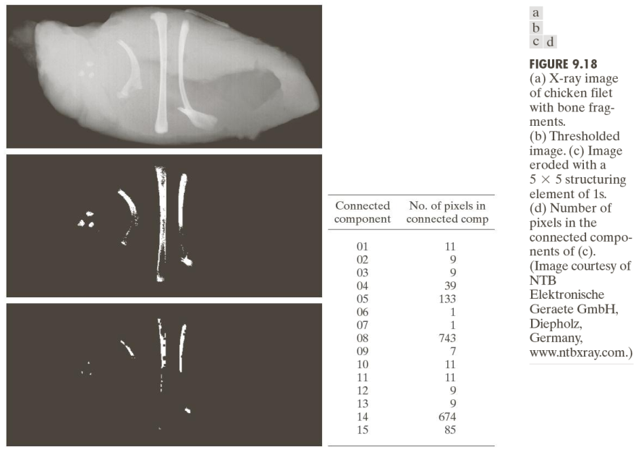
Extraction of Connected Components

Slide 55
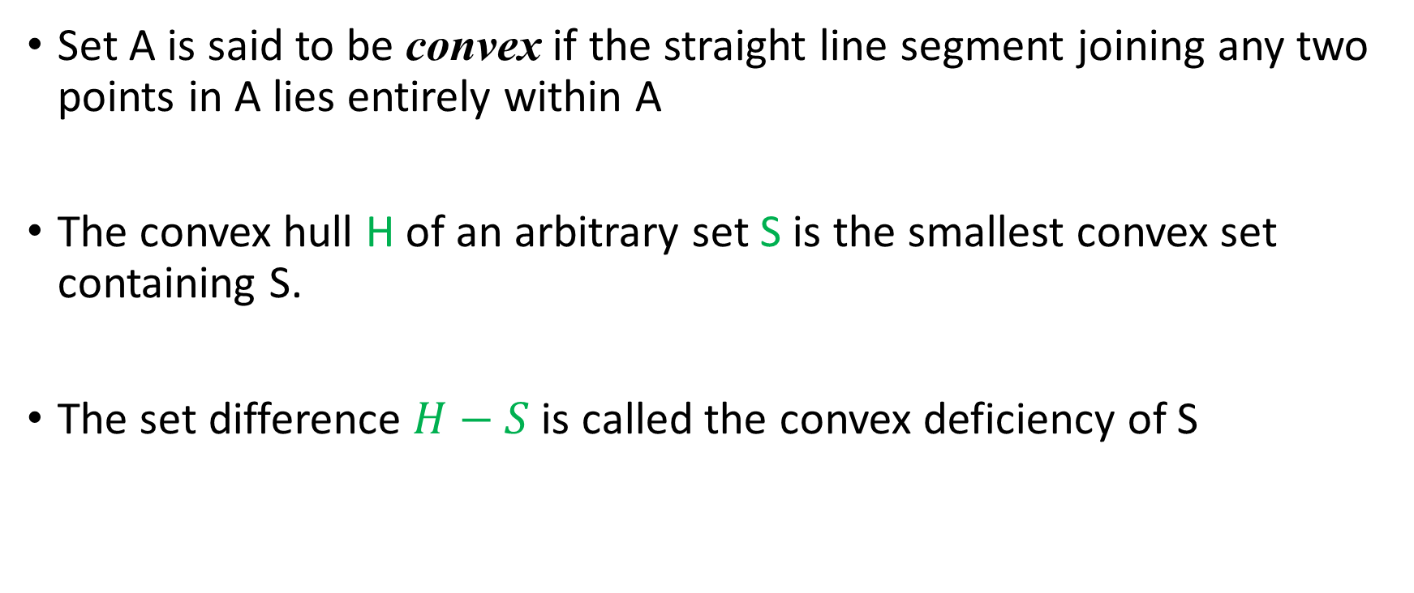
Convex Hull
Set A is said to be convex if the straight line segment joining any two points in A lies entirely within A
The convex hull H of an arbitrary set S is the smallest convex set containing S.
The set difference $H−S$is called the convex deficiency of S

Slide 56
Convex Hull
Convex set
Convex set S₁
Not Convex set S₂

Slide 57
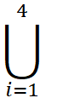
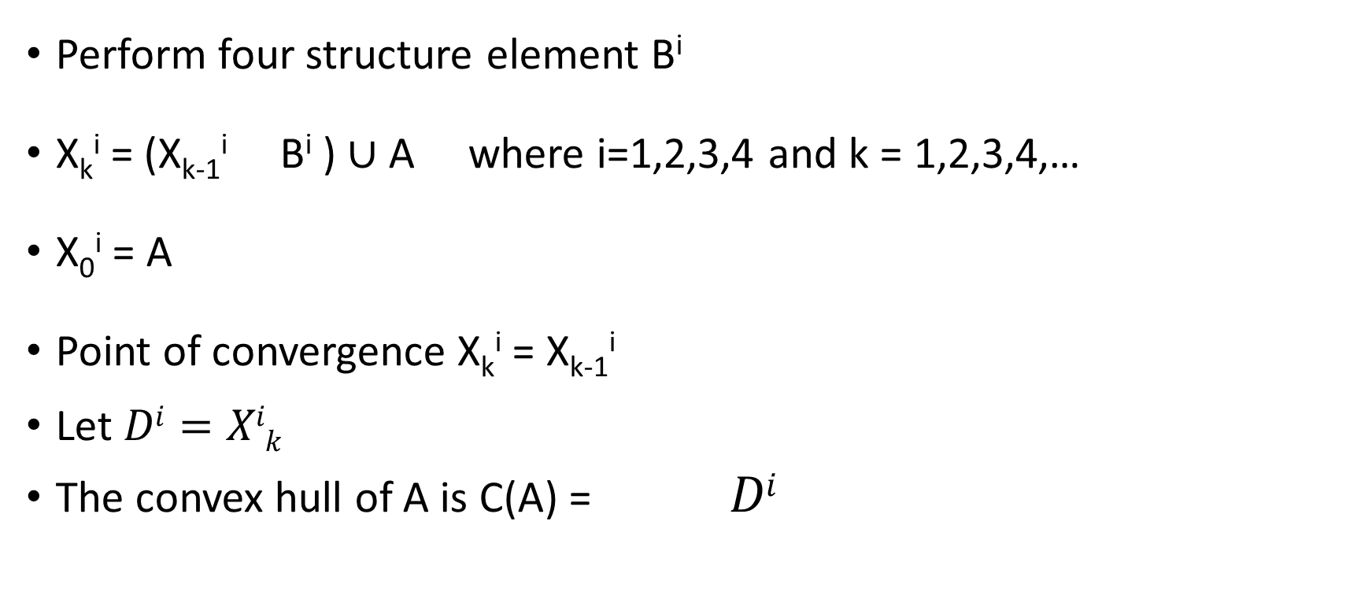
Perform four structure element B^{i}
X_{k}^{i} = (X_{k-1}^{i} B^{i} ) $∪$ A where i=1,2,3,4 and k = 1,2,3,4,…
X₀^{i} = A
Point of convergence X_{k}^{i} = X_{k-1}^{i}
Let $Di=Xik$
The convex hull of A is C(A) = $Di$

Slide 58
Convex Hull
B¹
B²
 | × | ×
 |  | ×
 | × | ×
× |  | ×
× | × | ×
B³
B⁴
× | ×
×
× | ×
× | × | ×
× |  | ×
^{Set A}

Slide 59
Convex Hull
B¹
 | × | ×
 |  | ×
 | × | ×
 |  |  |  |  |  | 1
 |  |  |  |  |  | 1
 |  |  |  |  |  | 1
 |  |  |  |  |  |  | 1
Iteration 1
X₁¹

Slide 60
Convex Hull
B¹
 | × | ×
 |  | ×
 | × | ×
 |  |  |  |  |  | 1
 |  |  |  |  |  | 1
 |  |  |  |  |  | 1
 |  |  |  |  |  |  | 1
Iteration 1
X₁¹

Slide 61
Convex Hull
B¹
 | × | ×
 |  | ×
 | × | ×
 |  |  |  |  |  | 1 | 2
 |  |  |  |  |  | 1
 |  |  |  |  |  | 1
 |  |  |  |  |  |  | 2
 |  |  |  |  |  |  | 1
Iteration 2
X₂¹

Slide 62
Convex Hull
B¹
 | × | ×
 |  | ×
 | × | ×
 |  |  |  |  |  | 1 | 2
 |  |  |  |  |  | 1 |  | 3
 |  |  |  |  |  | 1 |  | 3
 |  |  |  |  |  |  | 2 | 3
 |  |  |  |  |  |  | 1
Iteration 3
X₃¹

Slide 63
Convex Hull
B¹
 | × | ×
 |  | ×
 | × | ×
 |  |  |  |  |  | 1 | 2
 |  |  |  |  |  | 1 |  | 3
 |  |  |  |  |  | 1 |  | 3 | 4
 |  |  |  |  |  |  | 2 | 3
 |  |  |  |  |  |  | 1
Iteration 4
X₄¹

Slide 64
Convex Hull
B¹
 | × | ×
 |  | ×
 | × | ×
 |  |  |  |  |  | 1 | 2
 |  |  |  |  |  | 1 |  | 3
 |  |  |  |  |  | 1 |  | 3 | 4
 |  |  |  |  |  |  | 2 | 3
 |  |  |  |  |  |  | 1
Iteration 5
X₅¹ =X₄¹
Process terminate

Slide 65
Convex Hull
B²
× |  | ×
× | × | ×
 |  |  |  |  |  | 1 | 2
 |  |  | 1 |  |  | 1 |  | 3
 |  |  |  |  |  | 1 |  | 3 | 4
 |  |  |  |  |  |  | 2 | 3
 |  |  |  |  | 1 |  | 1
Iteration 1
X₁²

Slide 66
Convex Hull
B²
× |  | ×
× | × | ×
 |  |  |  |  |  | 1 | 2
 |  |  | 1 |  |  | 1 |  | 3
 |  |  |  |  |  | 1 |  | 3 | 4
 |  |  |  |  |  |  | 2 | 3
 |  |  |  |  | 1 |  | 1
Iteration 2
X₂² =X₁²
Process terminate

Slide 67
Convex Hull
B³
× | ×
×
× | ×
 |  |  |  |  |  | 1 | 2
 |  |  | 1 |  |  | 1 |  | 3
 |  |  | 1 |  |  | 1 |  | 3 | 4
 |  |  |  |  |  |  | 2 | 3
 |  |  |  | 1 | 1 |  | 1
 |  |  |  | 1
Iteration 1
X₁³

Slide 68
Convex Hull
B³
× | ×
×
× | ×
 |  |  |  |  |  | 1 | 2
 |  | 2 | 1 |  |  | 1 |  | 3
 |  |  | 1 |  |  | 1 |  | 3 | 4
 |  |  | 2 |  |  |  | 2 | 3
 |  |  | 2 | 1 | 1 |  | 1
 |  |  |  | 1
Iteration 2
X₂³

Slide 69
Convex Hull
B³
× | ×
×
× | ×
 | 3 |  |  |  |  | 1 | 2
 |  | 2 | 1 |  |  | 1 |  | 3
 |  | 3 | 1 |  |  | 1 |  | 3 | 4
 |  | 3 | 2 |  |  |  | 2 | 3
 |  |  | 2 | 1 | 1 |  | 1
 |  |  |  | 1
Iteration 3
X₃³

Slide 70
Convex Hull
B³
× | ×
×
× | ×
 | 3 |  |  |  |  | 1 | 2
 | 4 | 2 | 1 |  |  | 1 |  | 3
 | 4 | 3 | 1 |  |  | 1 |  | 3 | 4
 |  | 3 | 2 |  |  |  | 2 | 3
 |  |  | 2 | 1 | 1 |  | 1
 |  |  |  | 1
Iteration 4
X₄³

Slide 71
Convex Hull
B³
× | ×
×
× | ×
 | 3 |  |  |  |  | 1 | 2
5 | 4 | 2 | 1 |  |  | 1 |  | 3
 | 4 | 3 | 1 |  |  | 1 |  | 3 | 4
 |  | 3 | 2 |  |  |  | 2 | 3
 |  |  | 2 | 1 | 1 |  | 1
 |  |  |  | 1
Iteration 5
X₅³

Slide 72
Convex Hull
B³
× | ×
×
× | ×
 | 3 |  |  |  |  | 1 | 2
5 | 4 | 2 | 1 |  |  | 1 |  | 3
 | 4 | 3 | 1 |  |  | 1 |  | 3 | 4
 |  | 3 | 2 |  |  |  | 2 | 3
 |  |  | 2 | 1 | 1 |  | 1
 |  |  |  | 1
Iteration 6
X₆³ =X₅³
Process terminate

Slide 73
Convex Hull
B⁴
× | × | ×
× |  | ×
 |  |  |  | 1
 | 3 |  |  |  |  | 1 | 2
5 | 4 | 2 | 1 |  |  | 1 |  | 3
 | 4 | 3 | 1 |  |  | 1 |  | 3 | 4
 |  | 3 | 2 |  |  |  | 2 | 3
 |  |  | 2 | 1 | 1 |  | 1
 |  |  |  | 1
Iteration 1
X₁⁴

Slide 74
Convex Hull
B⁴
× | × | ×
× |  | ×
 |  |  |  | 1
 | 3 |  |  |  |  | 1 | 2
5 | 4 | 2 | 1 |  |  | 1 |  | 3
 | 4 | 3 | 1 |  |  | 1 |  | 3 | 4
 |  | 3 | 2 |  |  |  | 2 | 3
 |  |  | 2 | 1 | 1 |  | 1
 |  |  |  | 1
Iteration 2
X₂⁴ =X₁⁴
Process terminate

Slide 75
Convex Hull
So the convex hull is
 |  |  |  | 1
 | 3 |  |  |  |  | 1 | 2
5 | 4 | 2 | 1 |  |  | 1 |  | 3
 | 4 | 3 | 1 |  |  | 1 |  | 3 | 4
 |  | 3 | 2 |  |  |  | 2 | 3
 |  |  | 2 | 1 | 1 |  | 1
 |  |  |  | 1

Slide 76
Convex Hull drawbacks
Convex hull is the minimal of convex set
 |  |  |  | 1
 | 3 |  |  |  |  | 1 | 2
5 | 4 | 2 | 1 |  |  | 1 |  | 3
 | 4 | 3 | 1 |  |  | 1 |  | 3 | 4
 |  | 3 | 2 |  |  |  | 2 | 3
 |  |  | 2 | 1 | 1 |  | 1
 |  |  |  | 1
 |  |  |  |  |  | 1 | 2
 |  | 2 | 1 |  |  | 1
 |  | 3 | 1 |  |  | 1
 |  | 3 | 2 |  |  |  | 2
 |  |  | 2 | 1 | 1 |  | 1
 |  |  |  | 1

Slide 77
Convex Hull drawbacks solution
Limit horizontal, vertical dimensions
 |  |  |  | 1
 | 3 |  |  |  |  | 1 | 2
5 | 4 | 2 | 1 |  |  | 1 |  | 3
 | 4 | 3 | 1 |  |  | 1 |  | 3 | 4
 |  | 3 | 2 |  |  |  | 2 | 3
 |  |  | 2 | 1 | 1 |  | 1
 |  |  |  | 1
 |  |  |  |  |  | 1 | 2
 |  | 2 | 1 |  |  | 1
 |  | 3 | 1 |  |  | 1
 |  | 3 | 2 |  |  |  | 2
 |  |  | 2 | 1 | 1 |  | 1
 |  |  |  | 1

Slide 78
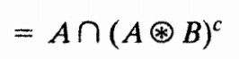
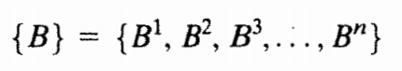
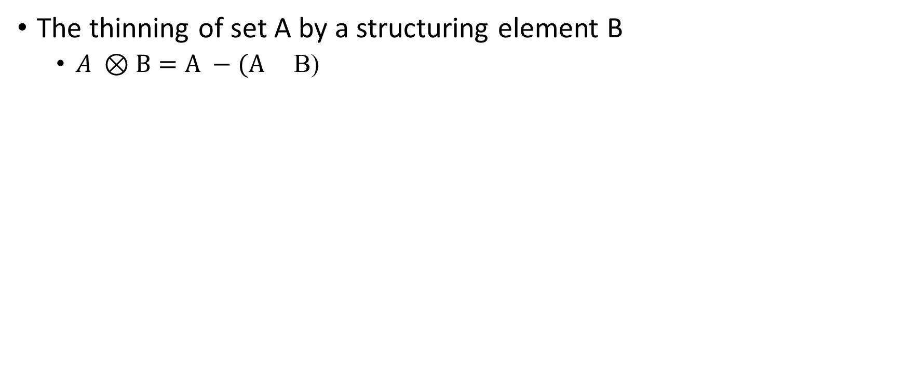
Thinning
The thinning of set A by a structuring element B
$A ⊗B=A −(A$ B)
A sequence of structuring element
Every B^{i} is the rotated version of B^{i-1}
Thinning is defined by

Slide 79
Thinning
× | * | ×
B¹
B²
B³
B⁴
B⁵
B⁶
B⁷
B⁸
Set A

Slide 80
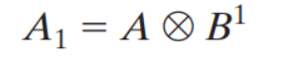
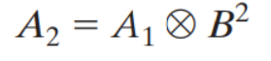
Thinning
× | * | ×
B¹
×
 | *
 |  | ×
B²

Slide 81
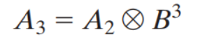
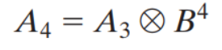
Thinning
 | ×
 | *
 | ×
B³
 |  | ×
 | *
×
B⁴

Slide 82
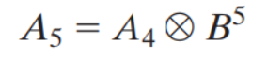
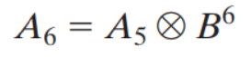
Thinning
× | * | ×
B⁵
×
 | *
 |  | ×
B⁶

Slide 83
Thinning
 | ×
 | *
 | ×
B⁷
A₈ = A₇ B⁷
 |  | ×
 | *
×
B⁸
A₉ = A₈ B⁸

Slide 84
Thinning
× | * | ×
B¹
A₁₀ = A₉ B¹
×
 | *
 |  | ×
B²
A₁₁ = A₁₀ B²

Slide 85
Thinning
 | ×
 | *
 | ×
B³
A₁₂ = A₁₁ B³
 |  | ×
 | *
×
B⁴
A₁₃ = A₁₂ B⁴

Slide 86
Thinning
× | * | ×
B⁵
A₁₄ = A₁₃ B⁵
No more change
converted to m-connectivity

Slide 87
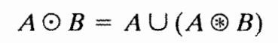
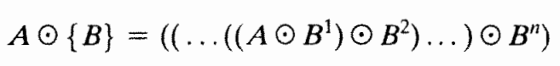
Thickening
Dual of Thinning
Operation A=> A^{c}
Calculate thinning of A^{c}
Then again calculate the complement of Thinning of A^{c}

Slide 88
Thickening
A^{c}
Set A
Thinning of A^{c}
Complement of thinning A^{c}

Slide 89
Thickening
Thickening
final result with no disconnected points

Slide 90
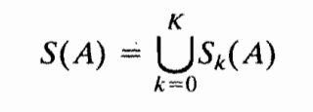
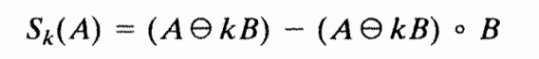
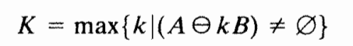
Skeletons
The skeleton of A can be expressed in term of erosion and openings

Slide 91
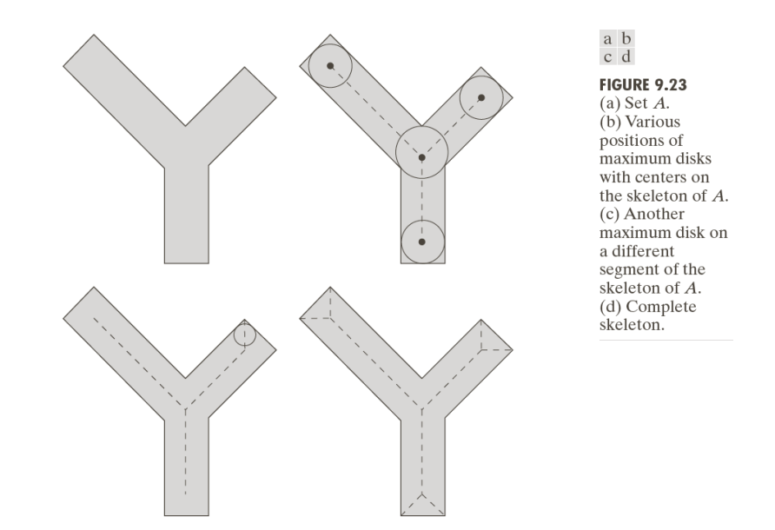
Skeletons

Slide 92
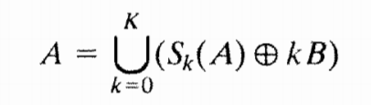
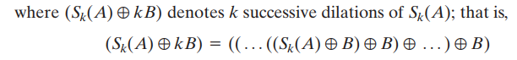
Skeletons
Using skeleton we can retrieved original points set A

Slide 93
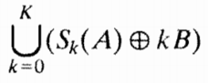


k=0
B

Slide 94
k=1

Slide 95
k=2

Slide 96




Pruning
Removing parasitic component
Essential Complement to thinning and skeletonizing

Slide 97


Structuring Elements
‘x’ indicates a “don’t care” condition

Slide 98


Step 1: Thinning
Apply this step a given (n) times to eliminate any branch with (n) or less pixels.
Step 2: Find End Points
Wherever the structuring elements are satisfied, the center of the 3x3 matrix is considered an endpoint.

Slide 99


Step 3: Dilate End Points
Perform dilation using a 3x3 matrix (H) consisting of all 1's and only insert 1's where the original image (A) also had a 1. Perform this for each endpoint in all direction (n) times.
Step 4: Union of X1 & X3
Take the result from step 1 and union it with step 3 to achieve the final results.

Slide 100



Slide 101



Slide 102


Slide 103

Pruning

Slide 104
Morphological Reconstruction
Morphological reconstruction that involves two images and a structuring element.
One image, the marker, contains the starting points for the transformation.
The other image, the mask, constrains the transformation. The structuring element is used to define connectivity

Slide 105


Geodesic dilation and erosion
Let F denote the marker image and G the mask image.
The geodesic dilation of size 1 of the marker image with respect to the mask
The geodesic dilation of size n of F with respect G to is defined as

Slide 106


Slide 107



Geodesic erosion

Slide 108



Morphological reconstruction by dilation and by erosion
Based on the preceding concepts, morphological reconstruction by dilation of a mask image G from a marker image F
Morphological reconstruction by erosion of a mask image G from a marker image F.

Slide 109


Slide 110

Opening by reconstruction:
The opening by reconstruction of size n of an image F is defined as the reconstruction by dilation of F from the erosion of size n of F that is,

Slide 111


Slide 112


Filling holes:

Slide 113


Slide 114



Border clearing:
In this application, we use the original image as the mask and the following marker image:

Slide 115


Slide 116
Gray scale Image
In gray scale images on the contrary to binary images we deal with digital image functions of the form
f(x,y) as an input image and
b(x,y) as a structuring element.
(x,y) represents a coordinates in the image.

Slide 117

Structuring elements
Structuring elements in gray-scale morphology belong to one of two categories: nonflat and flat.

Slide 118
Erosion for Gray scale Image
The erosion of f by a flat structuring element b at any location (x,y) is defined as the minimum value of the image in the region coincides with b when the origin of b is at (x,y).
The erosion of f by a non flat structuring element

Slide 119
Erosion– Gray-Scale
General effect of performing an erosion in grayscale images:
If all elements of the structuring element are positive, the output image tends to be darker than the input image.
The effect of bright details in the input image that are smaller in area than the structuring element is reduced, with the degree of reduction being determined by the grayscale values surrounding by the bright detail and by shape and amplitude values of the structuring element itself.

Slide 120
Dilation – Gray-Scale
The Dilation of f by a flat structuring element b at any location (x,y) is defined as the maximum value of the image in the region outlined by when the origin of is at (x,y).
The Dilation of f by a non flat structuring element

Slide 121
Dilation – Gray-Scale
The general effects of performing dilation on a gray scale image is twofold:
If all the values of the structuring elements are positive than the output image tends to be brighter than the input.
Dark details either are reduced or eliminated, depending on how their values and shape relate to the structuring element used for dilation

Slide 122


Erosion and Dilation for Gray scale image
Erosion and dilation are duals.

Slide 123




Opening and Closing for Gray scale Image
Opening –
Closing –

Slide 124
Some basic Gray-Scale Morphological Algorithms
Morphological Smoothing
Morphological gradient
Top-hat and bottom-hat transformations
Granulometry
Textural segmentation

Slide 125
Morphological Smoothing
Combination of opening and closing
Morphological filtering for smoothing
Noise removal
Automated Image analysis

Slide 126

Morphological Smoothing

Slide 127

Morphological gradient
Dilation and Erosion can be used in combination with image subtraction to obtain the morphological gradient of an image.
$$g=\left(f⊕b\right)−(fθb)$$
Emphasizes the boundaries between regions.

Slide 128
Morphological gradient

Slide 129

Top-hat and bottom-hat transformations
Combining image subtraction with openings and closings
$$That\left(f\right)=f−\left(f∘b\right)$$
B$hat\left(f\right)=\left(f⦁b\right)−f$
Removing objects from image by using structuring element
Correcting the effect of non-uniform illumination.
Great role in Segmentation

Slide 130

Top-hat and bottom-hat transformations

Slide 131
Granulometry
Determining the size distribution of particles in an image
Consists of applying openings with SEs of increasing size.

Slide 132
Granulometry

Slide 133


Slide 134
Textural segmentation
The objectives is to find a boundary between two regions based on their textural content.
Using closings and openings

Slide 135
Textural segmentation

Slide 136
References
Digital Image Processing 3rd edition, Rafael C. Gonzalez, Richard E. Woods
http://inside.mines.edu/~whoff/courses/EENG510/
https://en.wikipedia.org/wiki/Pruning_(morphology)
Special Thanks to Md. Shamimur Rahman

